Slide 1
Helwan university Faculty of engineering communication and electronics department
Number of students: five
Gamal Ibrahim (team leader)
Asmaa Abd el kreem
Toqaa Helal
Ayman Ramadan
Sara Yahia

Slide 2
Statement of problem: The challenge lies in the ability to reduce the hardware that measures the EEG signals so that the epilepsy patient can carry the device or install it on the brain while he is carrying out daily activities. The challenge in manufacturing the hardware that is able to suppress the brain signal during a seizure lies in the ability to enter this signal into the brain.

Slide 3
Some information about epilepsy:
Epilepsy is a central nervous system (neurological) disorder in which brain activity becomes abnormal, causing seizures or periods of unusual behavior, sensations, and sometimes loss of awareness.
Wikipedia
it affects about 50 million people worldwide, 80% of whom live in the developing world.
About 2.4 million people worldwide are diagnosed with epilepsy.
World Health Organization

Slide 4
Although there is a cure for some epilepsy cases and the price does not exceed 5 dollars, there are 30% of epilepsy patients who do not respond to treatment also, 75% of patients in low- and middle-income countries may not receive adequate treatment, which leads to a gaping gap. World health organization

Slide 5
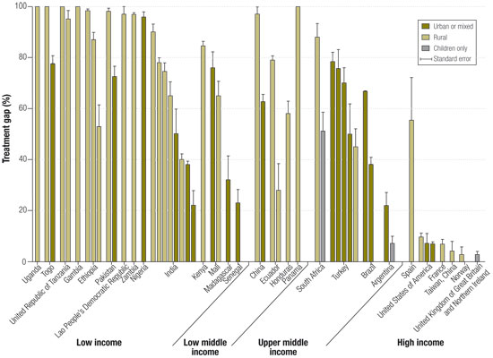

Slide 6
According to statistics in 2017, there are more than 20 million patients suffering from epileptic seizures, among them more than 5 million patients
suffer from intractable types that do not respond even to surgical intervention.
Also, the treatment of epilepsy is relatively high, as the price of the drug reaches 400 pounds, and sometimes the case needs a surgical intervention, costs estimated at 200 thousand pounds.
Elyom el sab3 , 2017

Slide 7
Expected deliverables:
The ability to measure EEG signal for brain
prediction of the occurrence of epileptic seizure before it happens
Sending a notification to the nearest pharmacy for the rescue
Detecting the location of the patient at the moment of seizure

